Slide 1
ECE 333 Green Electric Energy
Batteries and Water Pumping
Dr. Karl Reinhard
Dept. of Electrical and Computer Engineering
University of Illinois at Urbana-Champaign
reinhrd2@illinois.edu

Slide 2
Announcements
Final Exam 8 May, Rm 1013 ECE Bldg, 0800-1100
Quiz 10, Thursday, 26 April
Reading
Section 6.5 O-grid PV Systems with Battery Storage
Section 8.5 Hydroelectric Power
Section 9.4 Demand Side Management
Review (as needed)
Section 1.6 Financial Aspects (excluding sub-section 1.6.5)
Sections 6.4.1 6.4.3 PV Economics
Section 7.9 Wind Turbine Economics
Appendix A, Energy Economics Tutorial

Slide 3
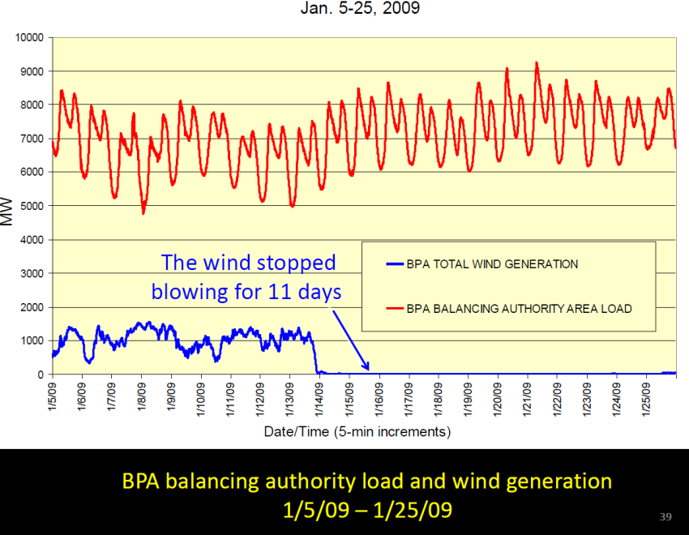
Key Issue – Renewable Sources Intermittency
Renewable energy from wind or solar PV cannot be stored in fuel form
Systems powered exclusively by renewable sources usually require some storage
In Jan 2009, Bonneville Power Admin (BPA) had ~ 0 wind for 20 days →
In Dec 2014 Chicago had 30 minutes of total sun in 10 days
Image Source: Steven Chu talk at NRC Next Generation Electric Grid Workshop, Irvine, CA, Feb 11, 2015

Slide 4
Battery I-V Curves
Energy is stored in batteries for most off-grid applications
An ideal battery is a voltage source V_{B}
A real battery has internal resistance R_{i}
FIGURE 6.22 An ideal battery has a vertical I–V characteristic curve.
Masters, Gilbert M. Renewable and Efficient Electric Power Systems, 2nd Edition.

Slide 5
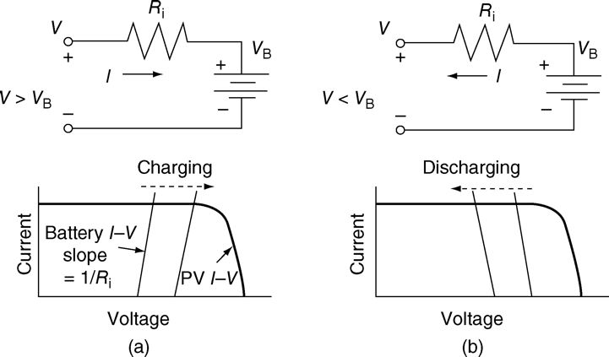
Battery I-V Curves
Charging: I-V line tilts right w/ slope 1/R_{i}, applied voltage must be greater than V_{B}
Discharging: I-V line tilts to the left with slope 1/R_{i}, terminal voltage is less than V_{B}
Blocking diodes used to avoid battery discharge in dark periods
FIGURE 6.23 A real battery can be modeled as an ideal battery in series with its internal resistance, with current flowing in opposite directions during charging (a) and discharging (b). During charging/discharging, the slightly tilted I–V curve slides right or left.
Masters, Gilbert M. Renewable and Efficient Electric Power Systems, 2nd Edition

Slide 6
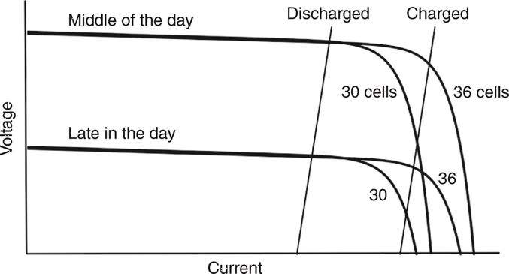
Hourly I-V Curves
Current at any voltage is proportional to insolation
V_{OC} drops as insolation decreases
Can just adjust the 1-sun I-V curve by shifting it up or down
FIGURE 6.24 A self-regulating PV module with fewer cells offers a risky approach to automatically controlling battery charging.
Masters, Gilbert M. Renewable and Efficient Electric Power Systems, 2nd Edition

Slide 7
Batteries and PV Systems
Batteries in PV systems provide storage, help meet surge current requirements, and provide a constant output voltage.
Lots of interest in battery research, primarily driven by the potential of pluggable hybrid electric vehicles
$2.4 billion awarded in August 2009
There are many different types of batteries, and which one is best is very much dependent on the situation
Cost, weight, number and depth of discharges, efficiency, temperature performance, discharge rate, recharging rates

Slide 8
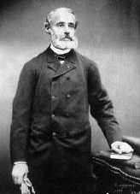
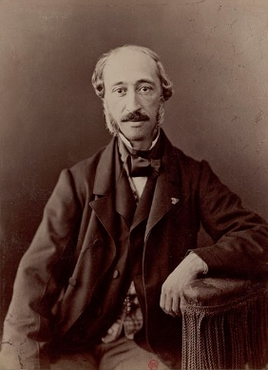
Lead Acid Batteries
Most common battery for larger-scale storage applications
Invented in 1859 by Gaston Plante (1834–1889), French Physicist
Served as Teaching Assistant to A. E. Becquerel (you recognize him having observed and documented the photovoltaic effect in 1839.
3 Major types:
Starting, Lighting and Ignition (SLI) – optimized for starting cars in which they are practically always close to fully charged,
Golf cart – used for running golf carts with fuller discharge, and
Deep-cycle – allow much more repeated charge/discharge such as in a solar application
https://en.wikipedia.org/wiki/Gaston_Plant%C3%A9 accessed 25 Feb 18
(https://en.wikipedia.org/wiki/Edmond_Becquerel accessed 9 Feb 18 )

Slide 9
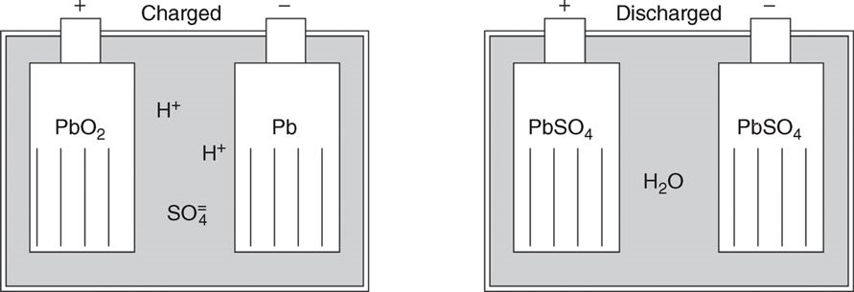
Basics of Lead-Acid Batteries
FIGURE 6.27 A lead–acid battery in its charged and discharged states.
Masters, Gilbert M. Renewable and Efficient Electric Power Systems, 2nd Edition.

Slide 10
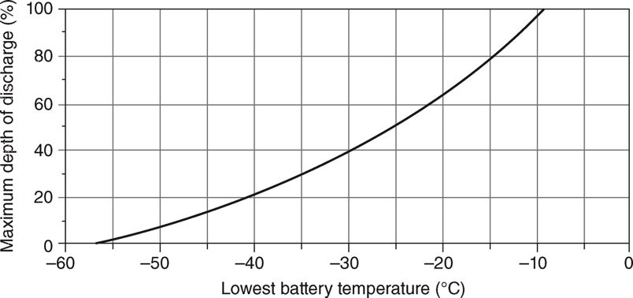
Lead-Acid Battery Basics
FIGURE 6.26 Battery freezing limits the allowable lead–acid battery discharge depth.
Masters, Gilbert M. Renewable and Efficient Electric Power Systems, 2nd Edition.
Discharged Batteries are more vulnerable to freezing as the antifreeze action of the sulfuric acid is diminished
Fully discharged will freeze at around −8°C (17°F),
Fully charged will not freeze until the electrolyte drops below −57°C (−71°F).

Slide 11
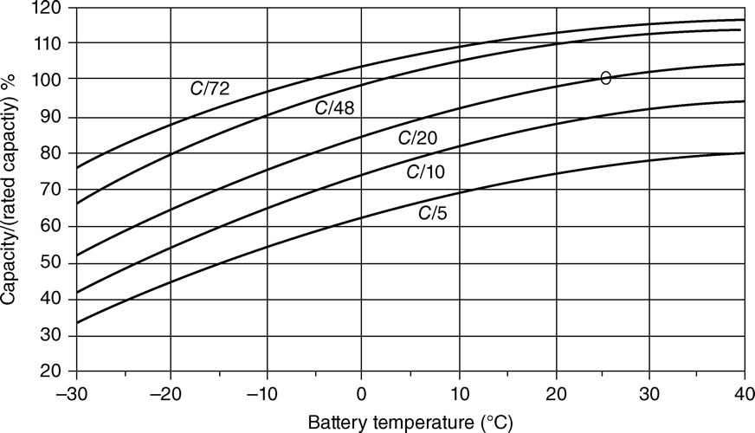
Lead-Acid Battery Basics
FIGURE 6.28 Lead–acid battery capacity depends on discharge rate and temperature. The capacity percentage ratio is based on a rated capacity at C/20 and 25°C.
Masters, Gilbert M. Renewable and Efficient Electric Power Systems, 2nd Edition.
During discharge – voltage and electrolyte specific gravity drops
Sulfate adheres to the plates during discharge and comes back off when charging, but some of it becomes permanently attached
Battery capacity has tended to be specified in amp-hours (Ah) as opposed to an energy value; multiply by average voltage to get watt-hours

Slide 12
Battery Costs have Been Decreasing
$600
Graphite/High
Voltage NMC
Li-Metal Battery projection assumes cycle life, cell scale-up, and catastrophic failure issues have been resolved
$500
4V, NMC
Silicon/High
4.2V, 10% Si
Voltage NMC
System Cost ($/kWh)
Lithium-Metal or Lithium/Sulfur
$400
5x excess Li, 10% S
$320/kWh
$300
$256/kWh
$200
$235/kWh
$100
4.7 Volt
4.7 Volt, 30% Si
1.5x excess Li, 75% S, ~$80/kWh
$0
2012
2014
2016
2018
2020
Year
2022
2024
2026
2028
2030

Slide 13
Battery Technologies
Type | Density, Wh/kG | Cost $/kWh | Cycles | Charge time, hours | Power W/kg
Lead-acid, deep cycle | 35 | 50-100 | 1000 | 12 | 180
Nickel-metal hydride | 50 | 350 | 800 | 3 | 625
Lithium Ion | 170 | 500-100 | 2000 | 2 | 2500
The above values are just approximate; battery technology is rapidly changing, and there are many different types within each category.
For stationary applications lead-acid is hard to beat because of its low cost. It has about a 75% efficiency.
For electric cars lithium ion batteries appear to be the current front runner

Slide 14
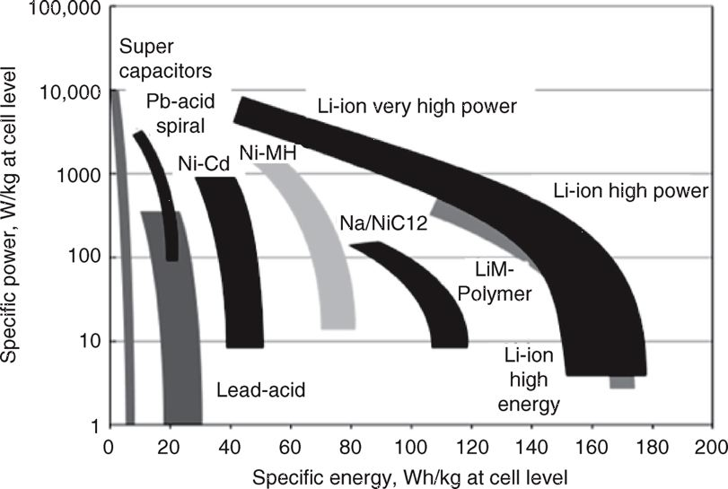
Battery Technologies
FIGURE 9.11 Specific power and specific energy for a number of battery types.
Masters, Gilbert M. Renewable and Efficient Electric Power Systems, 2nd Edition.
Source: International Energy Agency, Technology Roadmaps: Electric and Plug-in Hybrid Electric Vehicles, 2009, p. 12. (Original source: Johnson Control – SAFT 2005 and 2007.)

Slide 15
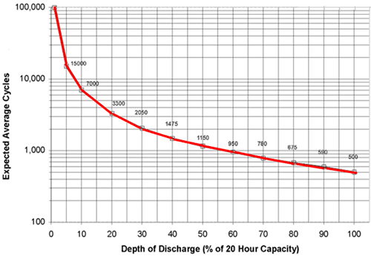
# of Cycles is Depth of Discharge Dependent
Lead Acid Battery Example
Ballpark is 1000 cycles at 50% discharge
If $100 /kWh ($200 per useable kWh), then the capital cost is $0.20/kWh
This does not include energy cost; ballpark roundtrip efficiency is 80%
Image Source: http://www.mpoweruk.com/life.htm

Slide 16
Lead Acid Battery Charging
Bulk stage - charger delivers fixed current I₁ until the voltage limit U₀ is reached.
Absorption stage - charger maintains voltage U₀ until the current tapers to I₂.
Float stage and termination – charger maintains I₁ indefinitely or until the charger is shut off or unplugged. This stage is ideal to maintain battery state of charge.
http://support.rollsbattery.com/support/solutions/articles/4345-agm-charging 24 Apr 18

Slide 17
Stand-Alone System Energy Needs
In many locations clouds can greatly reduce the available peak sun hours, sometimes for days at a time
As a minimum the average peak sun hours must at least meet the average load
Peak sun hours and perhaps the load have a seasonal dependence
Sufficient storage is needed to supply full load at times when the sun isn’t available
Probabilistic depending on location – how likely is a string of low sun days
Inverter and battery efficiencies need to be considered

Slide 18
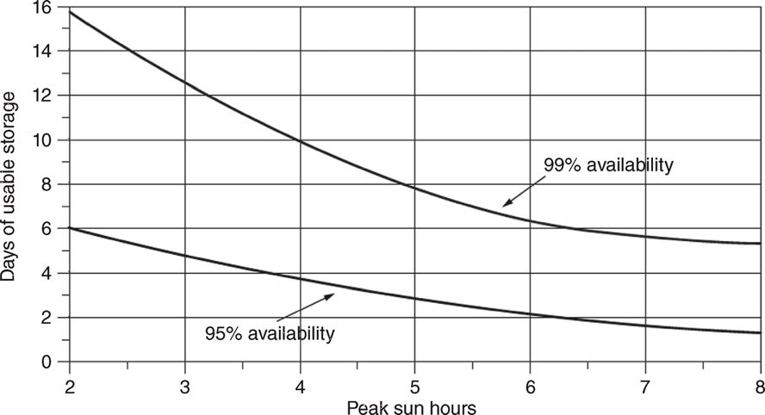
Estimating Storage Needs
FIGURE 6.31 Days of battery storage needed for a stand-alone system with 95% and 99% system availability. Peak sun hours are on a month-by-month basis.(Masters 376)
Masters, Gilbert M. Renewable and Efficient Electric Power Systems, 2nd Edition.

Slide 19
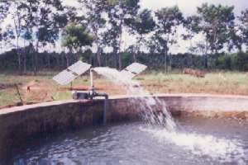
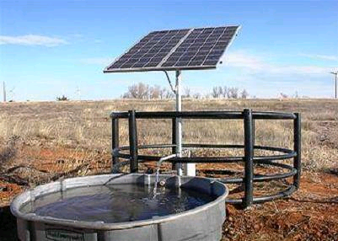
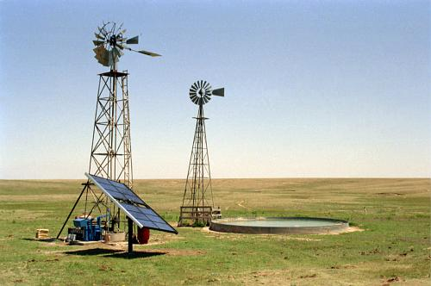
PV Powered Water Pumping
http://www.rajkuntwar.com/html/Solar.html
http://www.oksolar.com/pumps/
http://solar-investment.us/solar-pv-surface-and-bore-water-pumping/

Slide 20
Common PV System Usage: Pumping Water
PV systems are widely used for pumping water, particularly in developing countries; if water is stored, when it is pumped does not much matter
FIGURE 6.36 The electrical characteristics of the PV–motor combination need to be matched to the hydraulic characteristics of the pump and its load.
Masters, Gilbert M. Renewable and Efficient Electric Power Systems, 2nd Edition.

Slide 21
PV Pumping Water – Electro-Mechanical System
FIGURE 6.37 Showing the analogies between the I–V curves on (a) the electrical side and (b) the H–Q curves on the hydraulic side
Masters, Gilbert M. Renewable and Efficient Electric Power Systems, 2nd Edition.

Slide 22
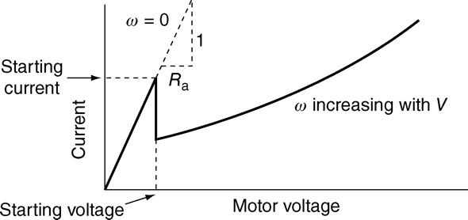
PV Pumping Water – Electrical System
FIGURE 6.38 Permanent magnet DC motor electrical model
Masters, Gilbert M. Renewable and Efficient Electric Power Systems, 2nd Edition.
FIGURE 6.39 Permanent magnet DC motor electrical characteristics.
Masters, Gilbert M. Renewable and Efficient Electric Power Systems, 2nd Edition.

Slide 23
Permanent Magnet DC Motor Example
A dc motor has V = 300 V, Rated armature current I = 60 A, R_{a} = 0.2 , and constant k = 3 V/rad/s.
What are
the speed (ω)
the torque at this speed (T)?
What is the starting torque (T_{start})?
Calculating ω_{m}
Calculate T_{m}
Calculate T_{start}
Losses can be very high!
Notes:
https://electronics.stackexchange.com/questions/39387/how-are-current-and-voltage-related-to-torque-and-speed-of-a-brushless-motor

Slide 24
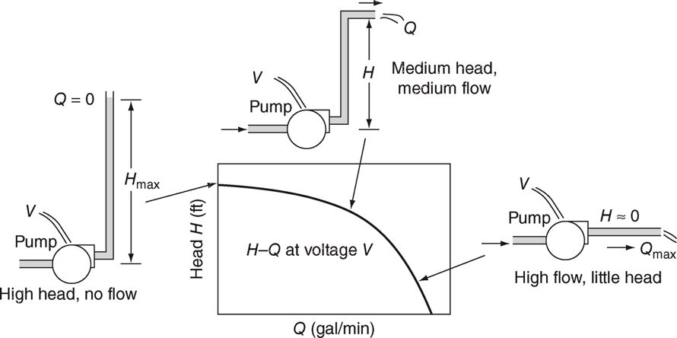
PV Pumping Water – Hydraulic system
FIGURE 6.41 Interpreting H–Q pump curves using a simple garden hose analogy.
Masters, Gilbert M. Renewable and Efficient Electric Power Systems, 2nd Edition.

Slide 25
PV Pumping Water – Hydraulic system
On the Hydraulic side, the load power is:

Slide 26
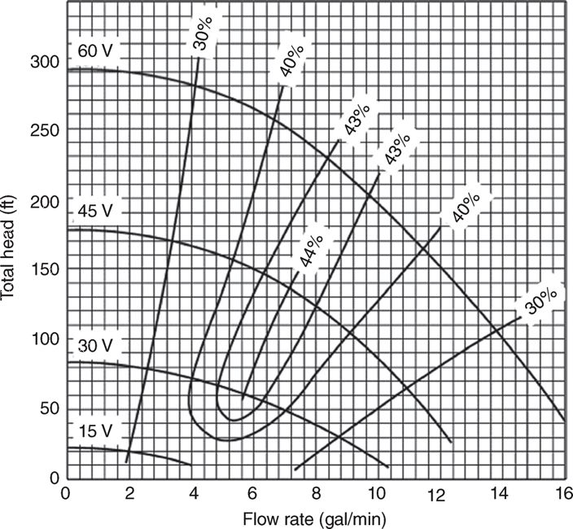
PV Pumping Water – Hydraulic system
DC centrifugal pump, intended for use with PVs
A typical “12-V” PV module operating near the knee of its I–V curve delivers about 15 V
15-, 30-, 45-, and 60-V inputs correspond to 1, 2, 3, 4, 5 PV modules in series
Pump efficiency is indicated as f (Q, H)
FIGURE 6.42 Pump curves for the Jacuzzi SJ1C11 pump for various input voltages. Pump efficiencies are also shown, with the peak along the knee of the curves.
Masters, Gilbert M. Renewable and Efficient Electric Power Systems, 2nd Edition.

Slide 27
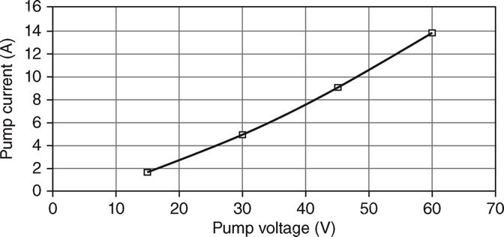
PV Pumping Water – Hydraulic system
FIGURE 6.43 The pump I–V curve derived from Figure 6.42.(Masters)
Masters, Gilbert M. Renewable and Efficient Electric Power Systems, 2nd Edition.

Slide 28
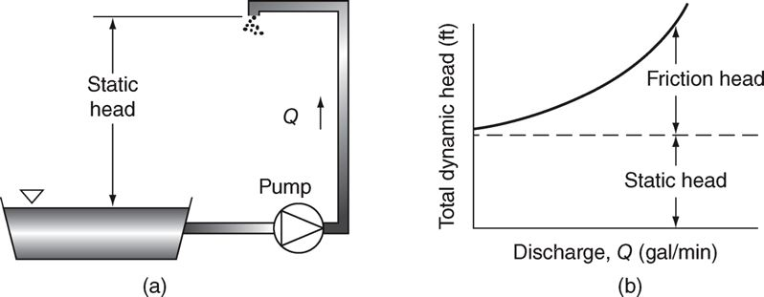
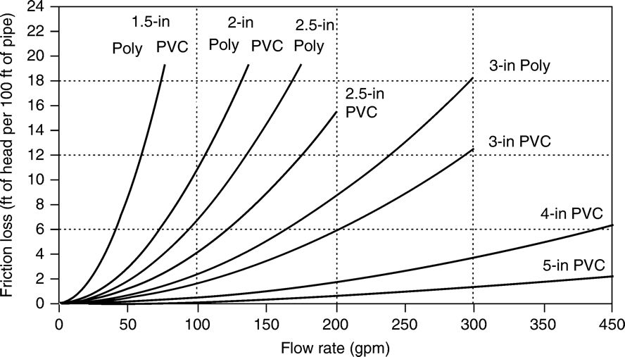
PV Pumping Water – Hydraulic system
FIGURE 6.44 An “open” system (a) and the resulting “system curve” (b) showing the static and friction head components.
Masters, Gilbert M. Renewable and Efficient Electric Power Systems, 2nd Edition.
FIGURE 8.35 Friction head loss, in feet of head per 100 ft of pipe, for 160-psi PVC piping and for polyethylene, SDR pressure-rated pipe.

Slide 29
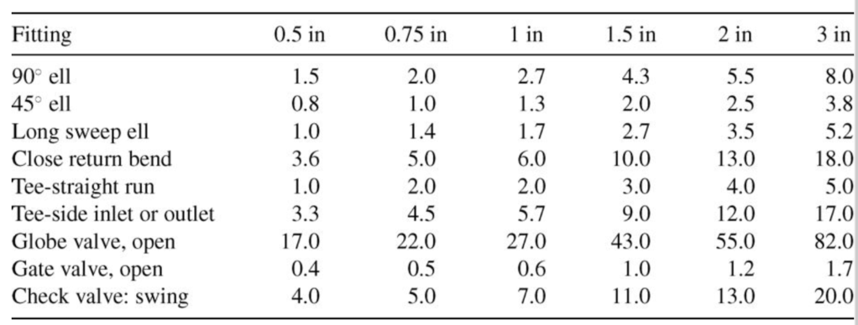
Pipe Losses
Frictional Losses for Valves and Elbows Expressed as Equivalent Length in Feet
Total head is the static head plus the frictional head

Slide 30
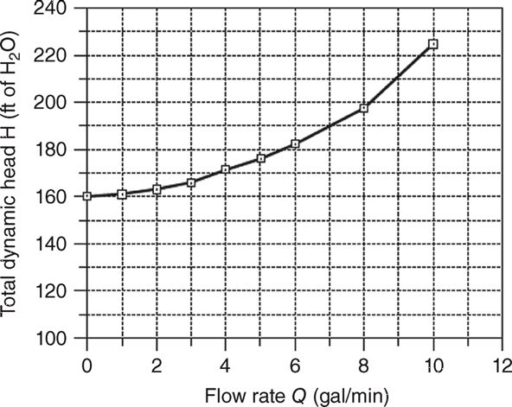
Example 6.16
Determine total head for below system as function of flow rate
Total pipe length, including elbows and valves is 251.5 ft
FIGURE 6.45 Ex 6.16 hydraulic system curve
Masters, Gilbert M. Renewable and Efficient Electric Power Systems, 2nd Edition.

Slide 31
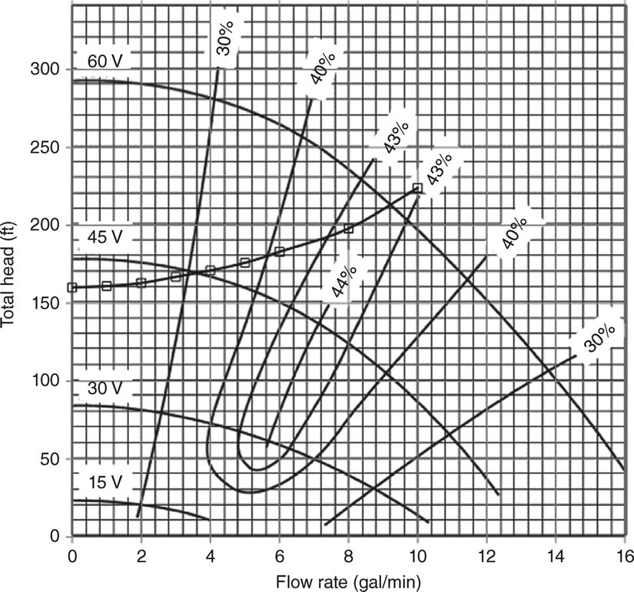
Example 6.16 Operating Points
Pump current can be determined from the head, flow rate, efficiency and voltage
FIGURE 6.46 The system curve for Example 6.17, 150-ft well, superimposed onto the pump curves for the Jacuzzi SJ1C11. No flow occurs until pump voltage exceeds about 40 V.
Masters, Gilbert M. Renewable and Efficient Electric Power Systems, 2nd Edition.

Slide 32
PV Pumping Water – Hydraulic system
FIGURE 6.46 The system curve for Example 6.17, 150-ft well, superimposed onto the pump curves for the Jacuzzi SJ1C11. No flow occurs until pump voltage exceeds about 40 V.
Masters, Gilbert M. Renewable and Efficient Electric Power Systems, 2nd Edition.

Slide 33
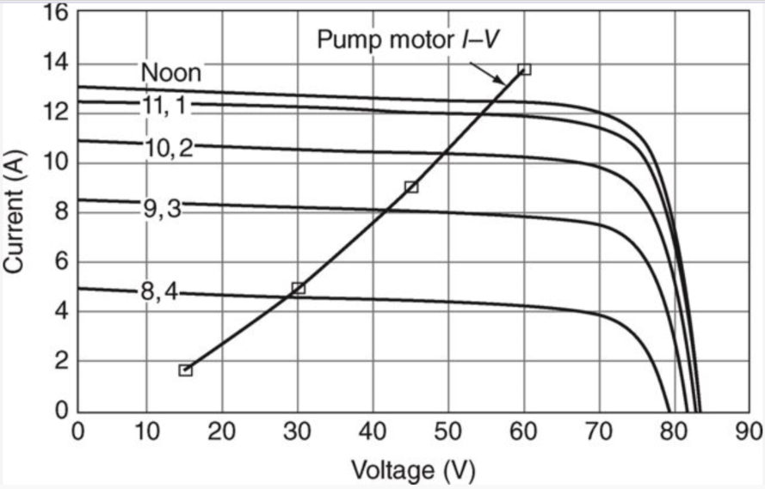
Putting it Together With Solar PV
Pump operating points can be determined for a range of voltages; these are superimposed on a solar PV V-I curve
This is used to determine how much water the configuration will pump

Slide 34
Ex: Energy to Pump Water from shallow well
How many kWh/day are required to pump 250 gallons/day with a 66 ft head + 230 ft pressure head assuming 35% efficiency?
With efficiency given, the equation 6.38 works for any rate, so calculate power required if the 250 gallons is pumped in one hour
Cost is about $0.05 or $0.02 per 100 gallons

Slide 35
Water Costs
Average person in US uses about 80 gallons per day
For Champaign-Urbana water is provided by Illinois American Water
Monthly fee is $39.10 for 1 inch supply, and $0.51 per 100 gallons (flat rate)
For Springfield, IL water provided by the city (CWLP)
Monthly fee is $26.94 for 1 inch supply, and $2.67 per unit (which is 100 cubic feet or 748 gallons); cost per 100 gallons is $0.357 (flat rate)
For Los Angles (also municipal)
No monthly fee, Tier 1 rate is $0.646 per 100 gallons, rising to $0.823 for Tier 2 (Tier 1 allotment is based in part on lot size)
http://www.amwater.com/files/IL-pdf-Champaign%202015%20February%201.pdf
http://www.cwlp.com/customer/rates/water.html

Slide 36
Electricity Associated with Water Usage
Various numbers have been associated with how much electricity is associated with water uses
Location Dependent, with Illinois being lower because of more water drawn from wells and less irrigation
A California Energy Commission report put the value at 19% for California (see below reference)
Water is often transported long distances, with 6138 kWh/million gallons for Colorado River Water (about 10 times greater than an Illinois well!);
Desalination is about 13000 kWh/million gallons
Wastewater treatment is about 2500 kWh/MG
gov/2005publications/CEC-700-2005-011/CEC-700-2005-011-SF.PDF

Slide 37
Electricity Associated with Water Usage
Total electricity 2001 was 250,494 GWh
gov/2005publications/CEC-700-2005-011/CEC-700-2005-011-SF.PDF

Slide 38
Water and (Electric) Energy Intersection
Due to drought conditions, California is increasingly turning to desalinating sea water
Largest desalination plant in the Western Hemisphere Carlsbad, CA (operational 2015) to provide water for 300,000 people in San Diego at a cost of $1B
Produces ~ 5 million gallons per day using a reverse osmosis process
Energy requirement is estimated to be 10-14 MWh per million gallons
Provides 7% of San Diego County’s water supply
The most important users of desalinated water are in the Middle East, (mainly Saudi Arabia, Kuwait, the United Arab Emirates, Qatar and Bahrain), which uses about 70% of worldwide capacity;

